Slide 1
Lecture 10 Types of Studies-Continued

Slide 2
Review From Friday
Lurking variables
Experimental designs:
Completely randomized design
Randomized block design
Matched pairs design
Sampling designs:
Convenience sampling
Simple random sampling

Slide 3
Sources of Bias In Surveys
Bias – when a sample is not representative of the population of interest.
Undercoverage – Bias introduced by having a sampling frame that lacks representation from parts of the population
- non-random sampling designs are prone to undercoverage
Nonresponse Bias – When some of the sampled subjects cannot be reached or refuse to participate
- most surveys suffer from this kind of bias
- Current population survey of the U.S Census Bureau has a nonresponse rate of about 7%
Response Bias – When survey question is asked in a leading way or a subjects emotions affect how they respond
A large sample size does NOT guarantee an unbiased sample!

Slide 4
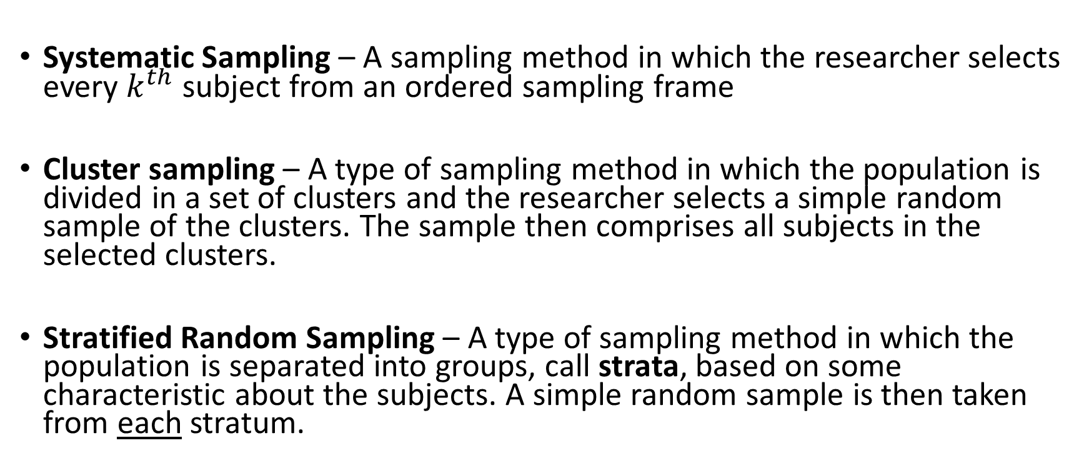
More complex methods of sampling
Systematic Sampling – A sampling method in which the researcher selects every $k^{th}$ subject from an ordered sampling frame
Cluster sampling – A type of sampling method in which the population is divided in a set of clusters and the researcher selects a simple random sample of the clusters. The sample then comprises all subjects in the selected clusters.
Stratified Random Sampling – A type of sampling method in which the population is separated into groups, call strata, based on some characteristic about the subjects. A simple random sample is then taken from each stratum.

Slide 5






Systematic Sampling
Simple Random Sampling
- selected
Stratified Random Sampling
- not selected
Cluster Sampling

Slide 6
More complex methods of sampling
Two – Stage cluster Sampling - A type of sampling method in which the population is divided into a set of clusters and the researcher selects a simple random sample of the clusters. A simple random sample is then applied to each cluster
Two – Stage Cluster Sampling

Slide 7
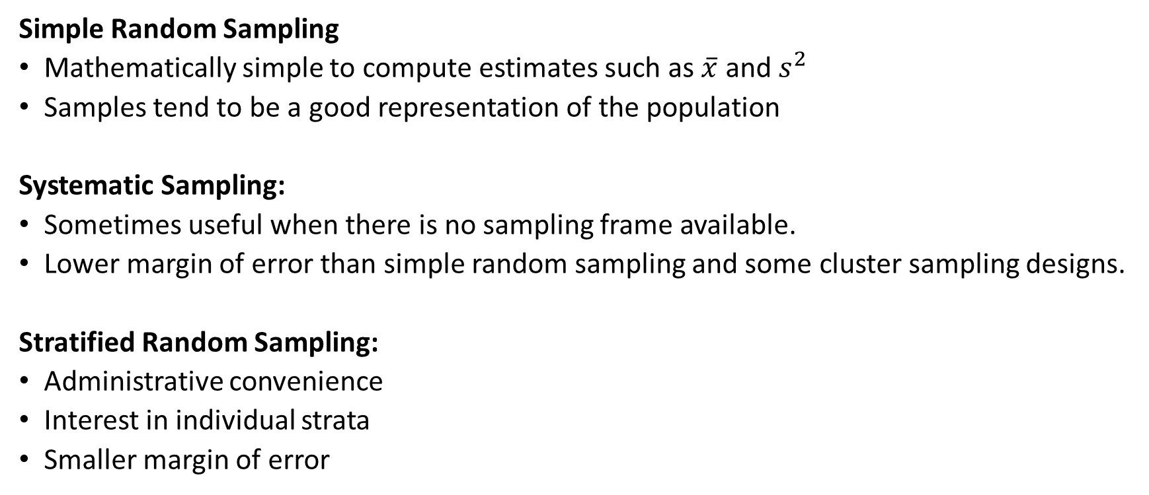
Advantages and Disadvantages of Sampling Designs
Simple Random Sampling
Mathematically simple to compute estimates such as $\overline{x}$ and $s^{2}$
Samples tend to be a good representation of the population
Systematic Sampling:
Sometimes useful when there is no sampling frame available.
Lower margin of error than simple random sampling and some cluster sampling designs.
Stratified Random Sampling:
Administrative convenience
Interest in individual strata
Smaller margin of error

Slide 8
Advantages and Disadvantages of Sampling Designs
Cluster Sampling:
can be less expensive than simple or stratified random sampling
can be used when a sampling frame is unavailable
margin of error is often larger than simple random sampling or stratified random sampling
Two-Stage Cluster Sampling:
Same advantages as above
Usually has a smaller margin of error, because we can control two sample sizes: the number of clusters to sample, and the number of elements to sample from each sampled cluster

Slide 9
Practice: identify the sampling design:
A researcher wants to gather opinions on a new smartphone model. Instead of randomly selecting participants, the researcher decides to conduct the survey in a shopping mall during a weekday afternoon. The individuals approached for the survey are those who happen to be present at the mall during that specific time.
This is an example of what type of sampling design?
What is the sampling frame?

Slide 10
Practice: identify the sampling design:
A researcher is interested in studying social media usage patterns among different age groups. They divide the population into age groups (18-24, 25-34, 35-44, and 45+) and select a proportionate simple random sample from each age group.
This is an example of what type of sampling design?
What is the sampling frame?

Slide 11
Practice: identify the sampling design:
A researcher is interested in studying the academic performance of high school students in a large city. The researcher obtains a list of all schools in the city and selects a simple random sample of the schools. Next, the research selects a simple random sample of students from each school Then, a random selection of schools is made from this cluster list.
This is an example of what type of sampling design?
What is the sampling frame?

Slide 12
Ethical Considerations In Experiments and Surveys
What types of studies might require us to think about ethics?

Slide 13
Connection to statistical inference…
Bias of a statistic - concerns the center of a sampling distribution.
Variability of a statistic - concerns the spread of its sampling distribution
Sampling error - how close our estimate is from the true population parameter
- not to be confused with margin of error!

Slide 14
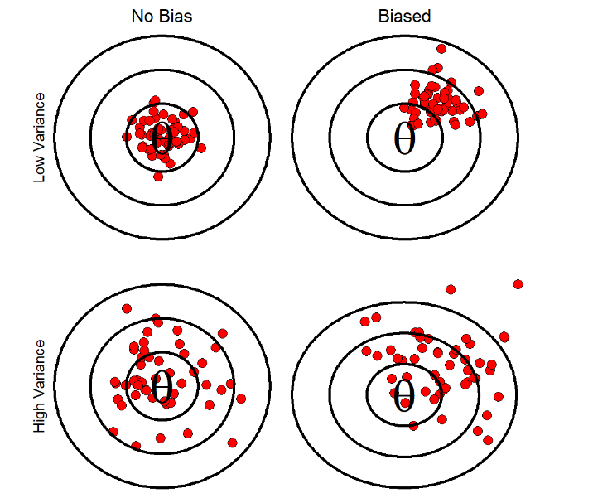
How do bias and variance effect the sampling error?
How are they related to the margin of error?

